Slide 1
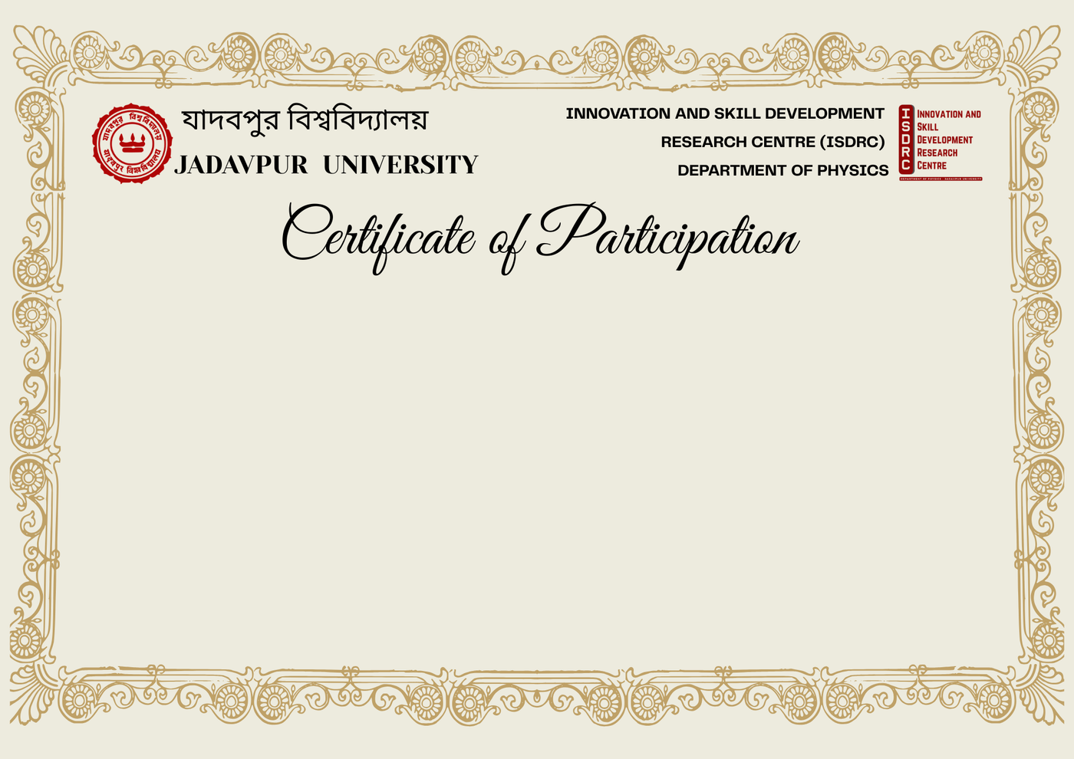

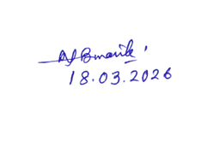

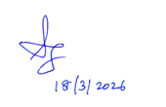
This is to certify that
Sutapa Baitalik ( Ghorui)
from Jadavpur University
has successfully presented a poster, entitled “Understanding The Fibrillation/Defibrillation of Aβ₁₋₄₀ Peptide Adsorbed In Bilayer Langmuir-Blodgett Film Matrix of Lipids”, at the One-Day National Seminar on Scientific Innovation and Skill Development for Societal Advancement, organised by the ISDRC, Department of Physics, Jadavpur University, Kolkata –700032, India, held on 18 March 2026.
The Organising Committee gratefully acknowledges his/her participation and contribution to this seminar.
Prof. Nabin Baran Manik
Coordinator, ISDRC
Department of Physics
Jadavpur University
Prof. Brajadulal Chattopadhyay
HOD
Department of Physics
Jadavpur University
Prof. Shamik Ghosh
Dean of Science
Department of Mathematics
Jadavpur University

